Slide 1
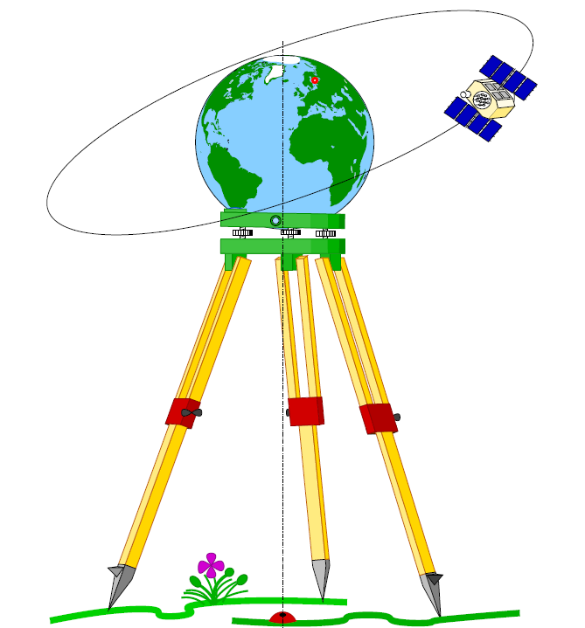
Geodesy

Slide 2
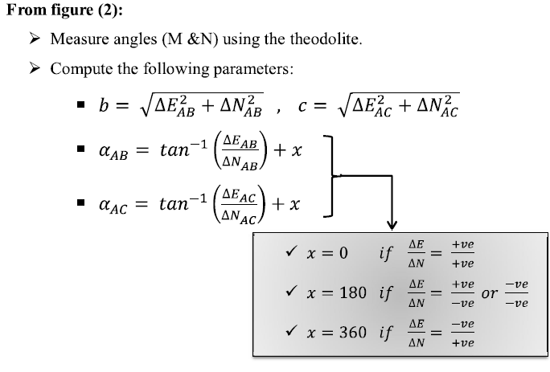

Slide 3
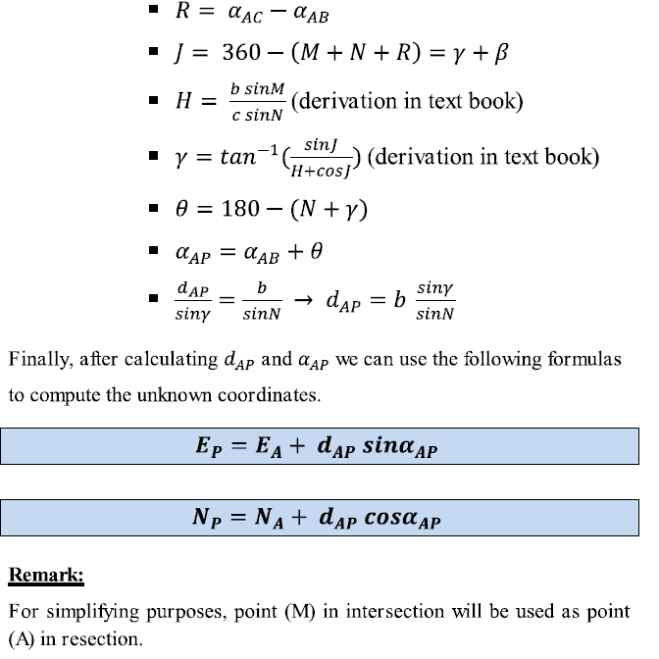

Slide 4
Spherical Excess
On the plane, the sum of the interior angles of any triangle is
exactly 180°.
On a sphere, the corresponding sum is always greater than 180°.
That is, 180° < α + β + γ
The positive quantity E = α + β + γ – 180° is called the spherical
excess of the triangle.
Since the sides of a spherical triangle are arcs, they can be
described as angles, and so we have two kinds of angles:

Slide 5
The angles at the vertices of the triangle,
formed by the great circles intersecting at the
vertices and denoted by Greek letters.
The sides of the triangle, measured by the
angle formed by the lines connecting the
vertices to the center of the sphere and
denoted by lower-case Roman letters.

Slide 6
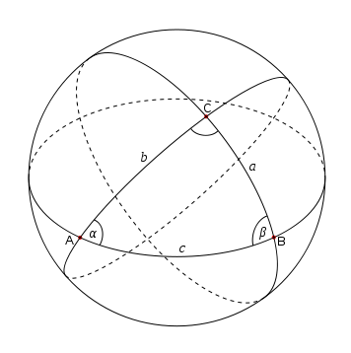
γ

Slide 7
The second kind of angle is most interesting. In contrast to
plane trigonometry, the sides of a spherical triangle are
themselves angles, and so we can take sines and cosines etc.
of the sides as well as the vertex angles.
Right spherical triangles
For this section, assume the angle γ = 90°, i.e. we have a
spherical right triangle. Then the following identities hold
Napier’s sine and cosine rule:
sin a = sin α sin c = tan b cot β
sin b = sin β sin c = tan a cot α
cos α = cos a sin β = tan b cot c
cos β = cos b sin α = tan a cot c
cos c = cot α cot β = cos a cos b

Slide 8
General spherical triangle
For this section we drop the assumption that γ = 90°.
Many identities hold. Here are a few examples:
Law of sines
sin α / sin a = sin β / sin b = sin γ / sin c
Law of cosines
cos a = cos b cos c + sin b sin c cos α
cos α = -cos β cos γ + sin β sin γ cos a
Tangents
Let s = (a + b + c)/2 and let σ = (α + β + γ)/2. The following formulas
can used to solve for a vertex angle from knowing the side arcs or
solve for a side arc from knowing the vertex angle:
tan (α/2) = √( sin(s–b) sin(s–c) / sin s sin(s–a) )
tan (a /2) = √( -cos(σ) cos(σ-α) / cos(σ-β) cos(σ-γ) )

Slide 9
Area
Let R be the radius of the sphere on which a triangle sides.
If angles are measured in radians area of a
triangle is simply =R² E
where E is the spherical excess.
In degrees the formula for area is: π R²E/180.
In seconds area is: R² E sin1“
Area = a . b sin C/2 or
Area = c² . SinA sinB / 2 sin (A+B)
Area = square root [tan s/2. tan (s-a)/2 . tan (s-b)/2 . tan (s-c)/2]

Slide 10
Auxiliary plane triangle
After reducing observations taken on the earth’s surface to the
reference ellipsoid, a group of connected triangles are solved as
plane triangles using the following relationship between sides
and angles:
a/b =sin A/sinB, b/c = sinB/sinC and c/a = sinC/sinA
The Legender’s theory states that the spherical triangle is
equivalent to a plane triangle where the lengths of sides in
both triangles are equals while the angles are differ from each
other by 1/3 of the spherical excess as follows:

Slide 11
C
γ
α γ
A B
A = α - E/3, B= β - E/3 and C= γ - E/3
Firstly, observations must be reduced to ellipsoidal
surface and E is computed as a function’s of the
triangle’s sides’ lengths.

